Slide 1
What time is it?

Slide 2
TIMUPS
Palak Gupta
Submitted To: Dr. Monika Gupta.. Dr. Randeep Kaur

Slide 3
01
Introduction
Matter:
02
Technology Used
03
Role and Purpose
04
Project Overview

Slide 4
Elegance Unveiled: Crafting the Front-End of Our Watch Website
Welcome to my project presentation, where we dive into the art of horology and web design, merging the timeless elegance of watches with the sleek functionality of an intuitive user interface.
Join me as I unveil the journey of crafting the front end of my exquisite watch website, where every click is a step towards luxury and sophistication.

Slide 5


Technology Used
HTML
01
HTML serves as the foundation for building web pages and is essential for displaying information on the internet.
CSS
03
CSS allows developers to define the appearance of HTML elements, including colors, fonts, and animations, to create visually appealing designs across a website.
BOOTSTRAP
02
Bootstrap streamlines the process of creating visually appealing and mobile-friendly websites, saving time and effort in design and development.
JAVASCRIPT
04
JavaScript enables features like user input validation, animations, and real-time updates, making websites more engaging and interactive for users.

Slide 6
Technology Used
(With Example)
CSS
HTML
03
CSS allows developers to define the appearance of HTML elements, including colors, fonts, and animations, to create visually appealing designs across a website.
01
HTML is like a blueprint and structure of a house with no functioning or design.
BOOTSTRAP
02
Bootstrap streamlines the process of creating visually appealing and mobile-friendly websites, saving time and effort in design and development.
JAVASCRIPT
04
JavaScript enables features like user input validation, animations, and real-time updates, making websites more engaging and interactive for users.

Slide 7
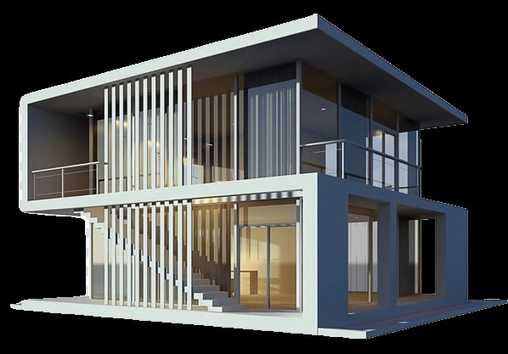
Technology Used
(With Example)
CSS
CSS & BOOTSTRAP
03
02
CSS allows developers to define the appearance of HTML elements, including colors, fonts, and animations, to create visually appealing designs across a website.
CSS and Bootstrap work as paint color & combinations, Home décor, furniture, lawns, etc.
BOOTSTRAP
02
Bootstrap streamlines the process of creating visually appealing and mobile-friendly websites, saving time and effort in design and development.
JAVASCRIPT
04
JavaScript enables features like user input validation, animations, and real-time updates, making websites more engaging and interactive for users.

Slide 8
Technology Used
(With Example)
CSS
JAVASCRIPT
03
03
CSS allows developers to define the appearance of HTML elements, including colors, fonts, and animations, to create visually appealing designs across a website.
Javascript adds the functioning of the electronics, the doors, the water system, etc.
BOOTSTRAP
CSS and Bootstrap work as paint color & combinations, Home décor, furniture, lawns, etc.
02
Bootstrap streamlines the process of creating visually appealing and mobile-friendly websites, saving time and effort in design and development.
JAVASCRIPT
04
JavaScript enables features like user input validation, animations, and real-time updates, making websites more engaging and interactive for users.

Slide 9
Role &
Purpose
Key Role
Designing the Website
Key Role
Purpose
Development of the Website
To showcase the working of the website

Slide 10
Project Overview
Revolutionizing Wearables: Front-End Excellence for Smart Watches
Goals
Objectives
Targeted Audience
Create Brand Name
Feasible in use
Millennials & Gen z

Slide 11
Project Overview
Revolutionizing Wearables: Front-End Excellence for Smart Watches
Goals
Objectives
Targeted Audience
Create Brand Name

Slide 12
Continue…
Revolutionizing Wearables: Front-End Excellence for Smart Watches
End Goals
Create a Brand Name
Increase Products Range
Enhance Footfall
User Retention

Slide 13
Continue…
.
Objectives
Goals
Targeted Audience
Feasible in use
.

Slide 14
Continue…
Objectives
Feasible to use
User Engagement
Quality
Ubiquitous
Customer Empathy
Targeted Audience
Goals
The website promises Quality over Quantity

Slide 15
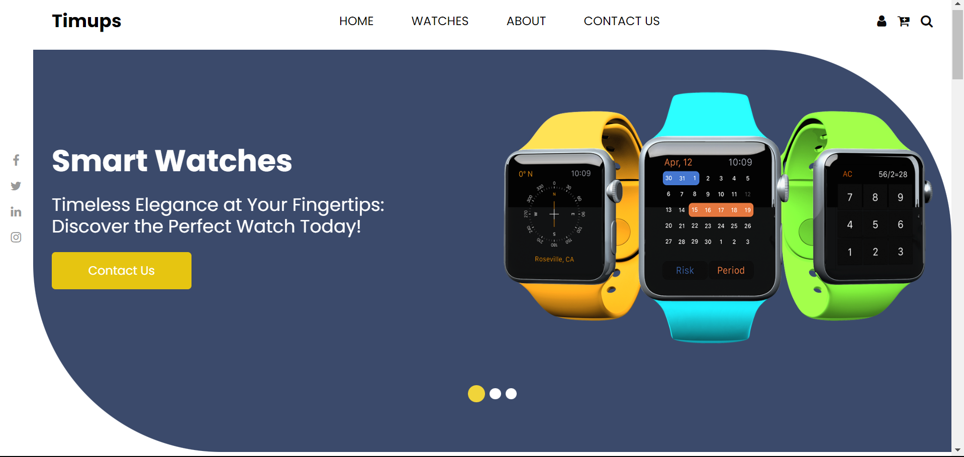
Objectives Continue.…
Feasible to use
Font styling is vivid and bold which is easy to read and access.
Icons used, make it easier to understand the purpose of the provided features.
The website is made more appealing by HD photos.
Targeted Audience
Goals
The website promises Quality over Quantity

Slide 16

Objectives Continue.…
Feasible to use
Targeted Audience
Goals
The website promises Quality over Quantity

Slide 17
Objectives Continue.…
Feasible to use
Targeted Audience
Goals
The website promises Quality over Quantity

Slide 18

Objectives Continue.…
User Engagement
The website is more useful and appealing as a result of the hovering effects.
The Catchy quotes make better UX and look promising.
Targeted Audience
Goals
QUOTES

Slide 19
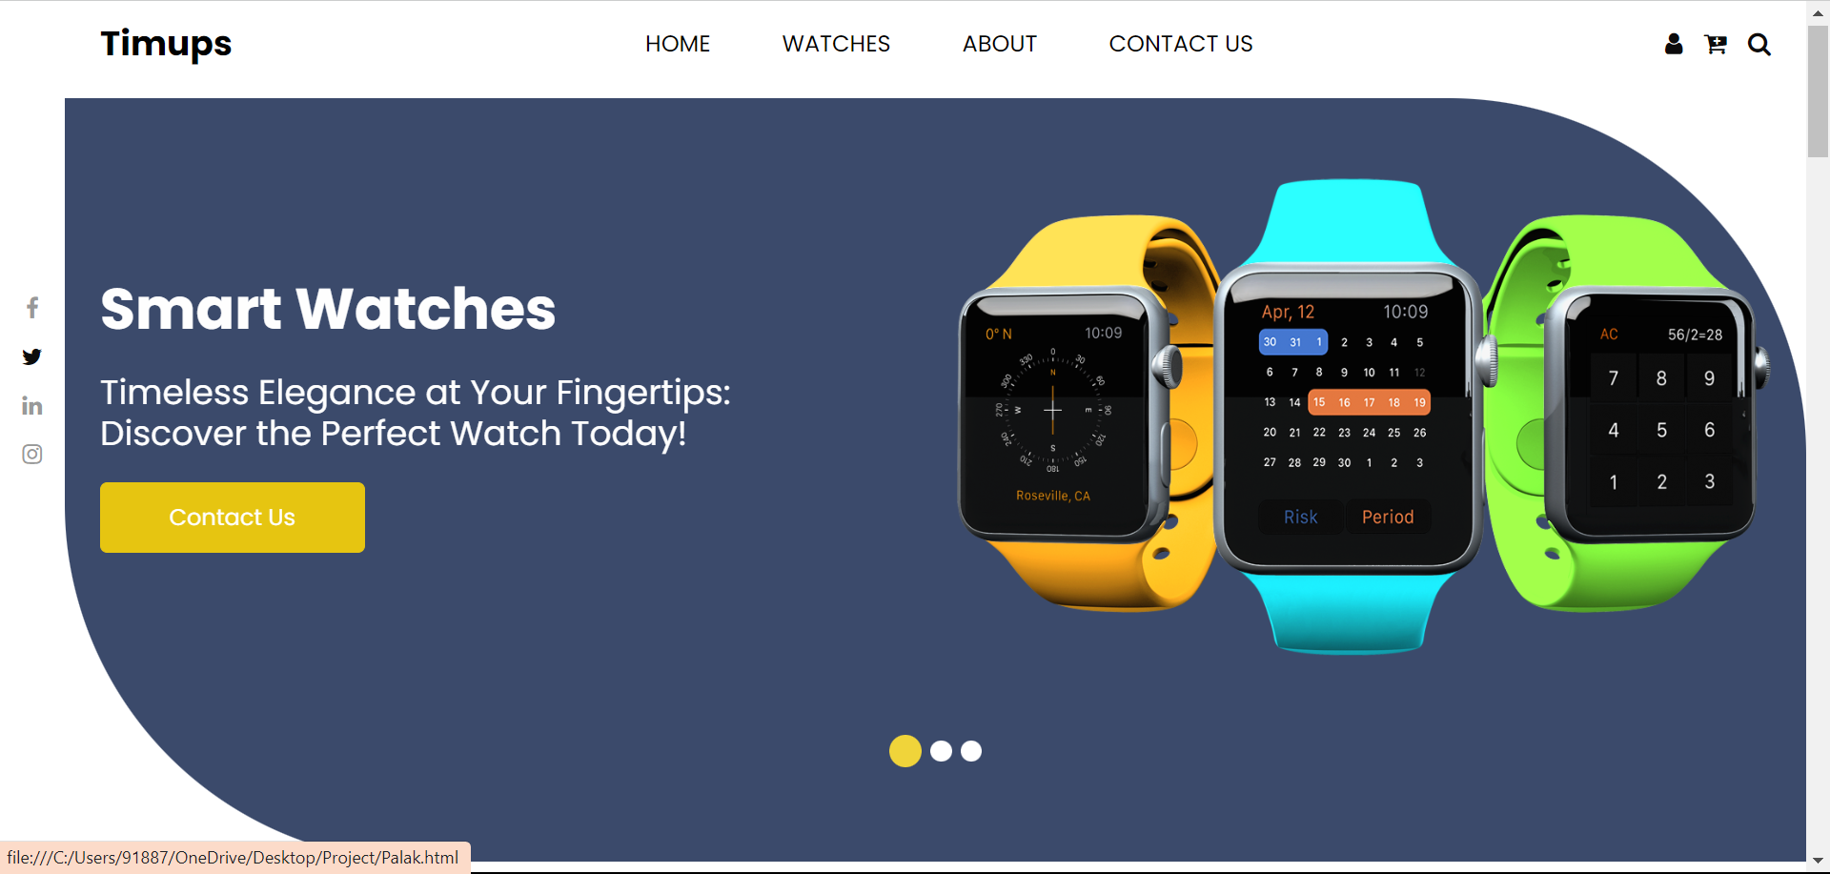
Objectives Continue.…
User Engagement
Targeted Audience
Goals
The website promises Quality over Quantity

Slide 20
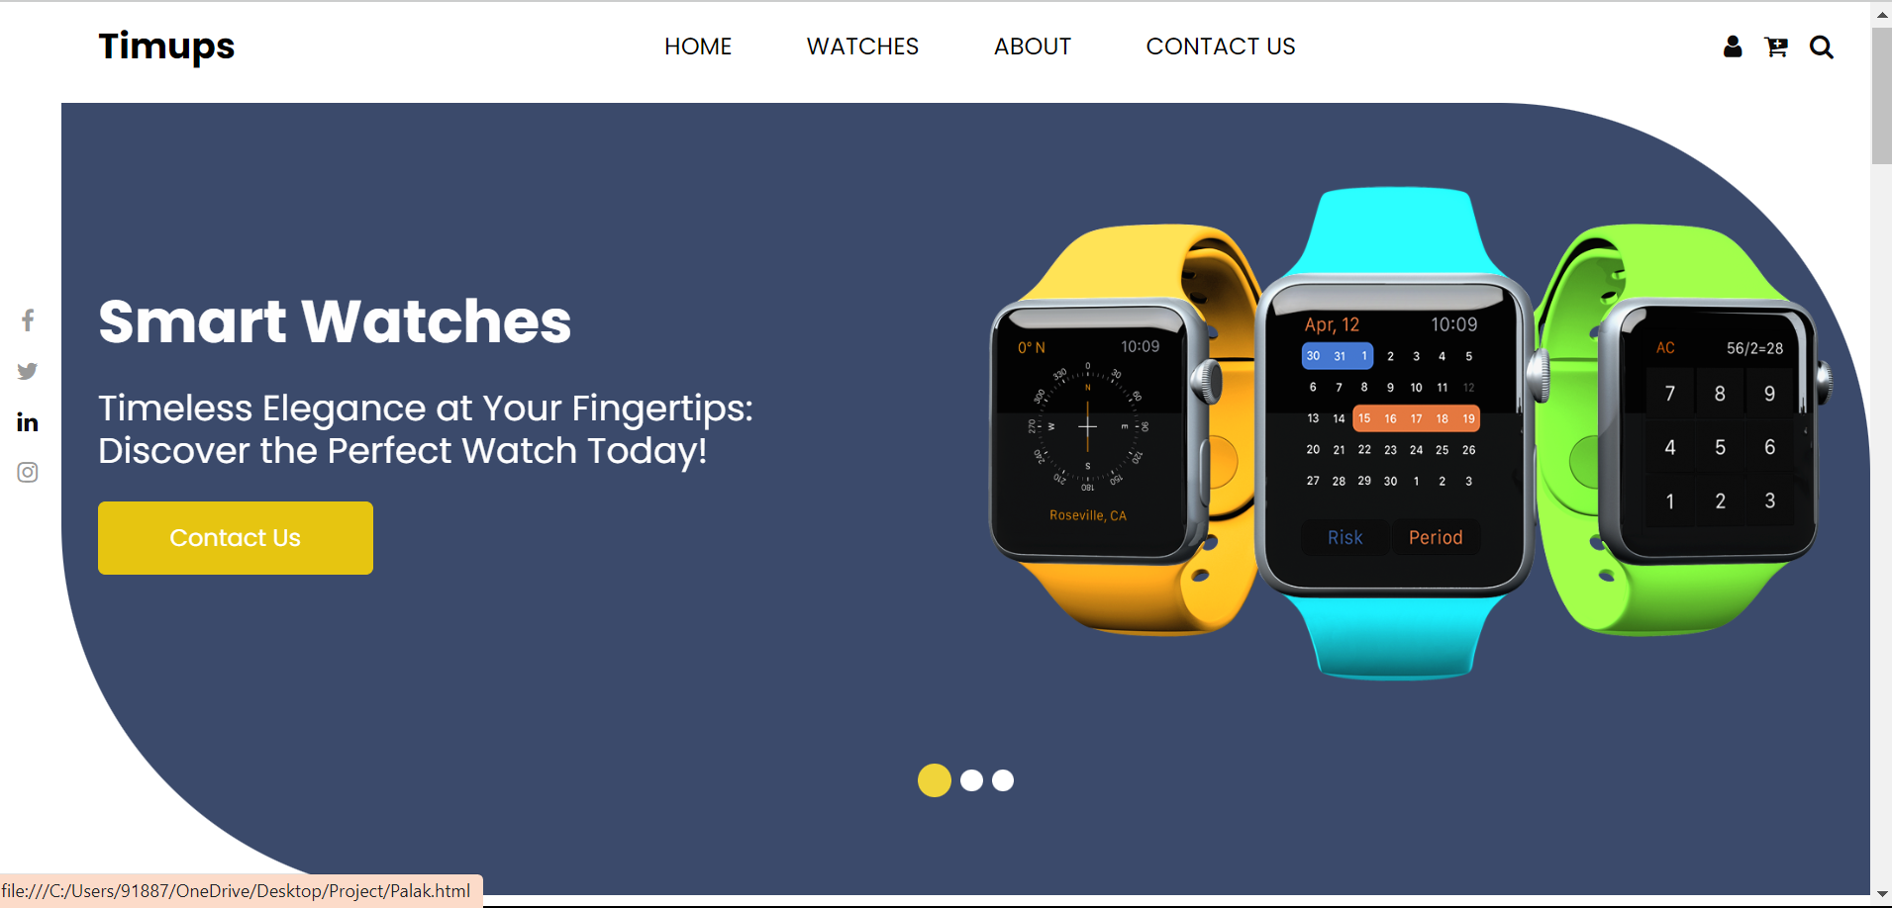
Objectives Continue.…
User Engagement
Targeted Audience
Goals
The website promises Quality over Quantity

Slide 21


Objectives Continue.…
User Engagement
Targeted Audience
Goals
The website promises Quality over Quantity

Slide 22
Objectives Continue.…
User Engagement
Targeted Audience
Goals
The website promises Quality over Quantity

Slide 23
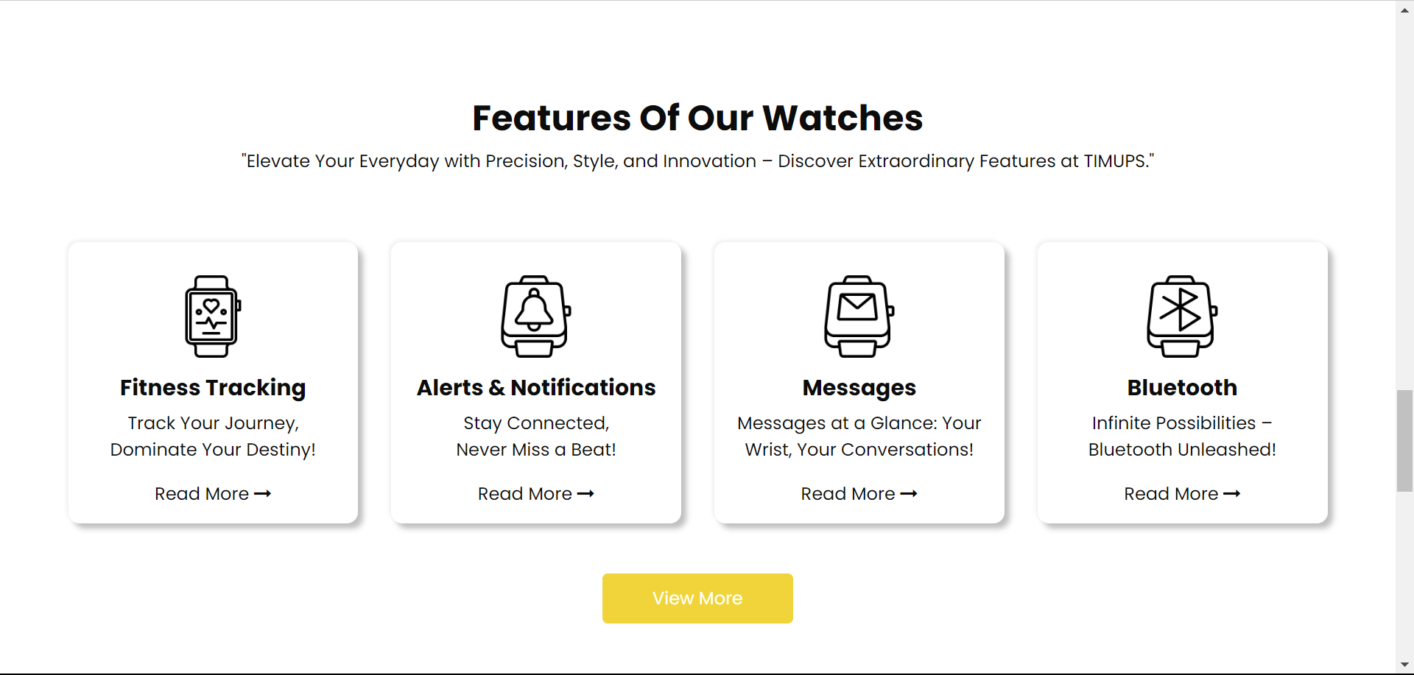

Objectives Continue.…
User Engagement
Targeted Audience
Goals
The website promises Quality over Quantity

Slide 24
Objectives Continue.…
User Engagement
Targeted Audience
Goals
The website promises Quality over Quantity

Slide 25
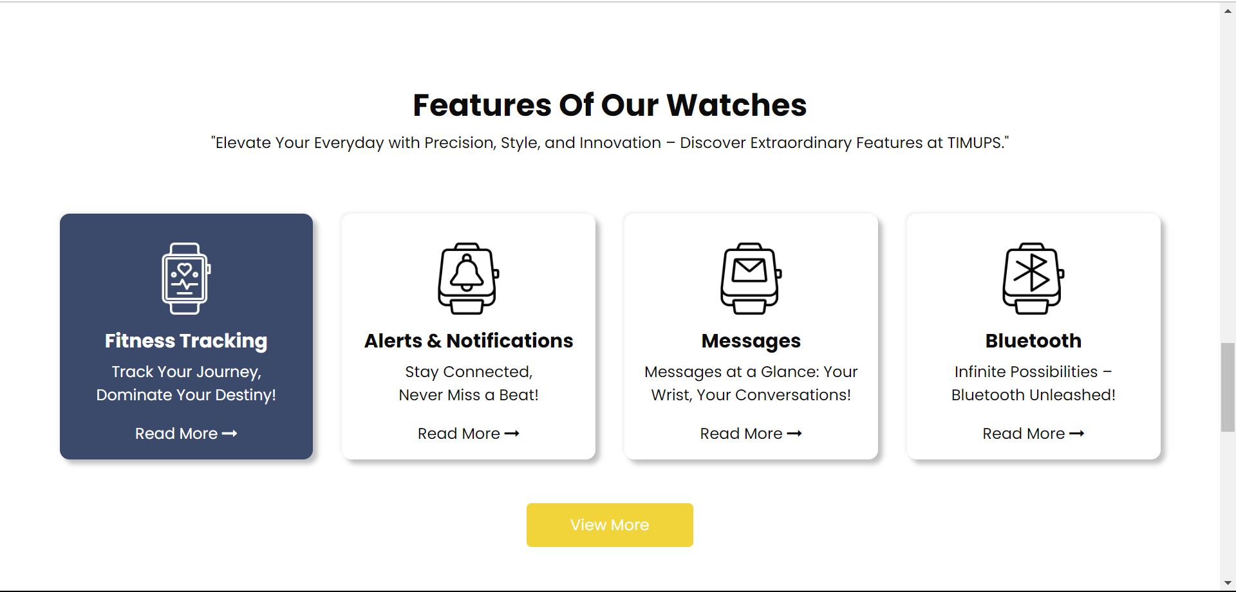
Objectives Continue.…
User Engagement
Targeted Audience
Goals
The website promises Quality over Quantity

Slide 26
Objectives Continue.…
Quality
Targeted Audience
Goals
The website promises Quality over Quantity

Slide 27
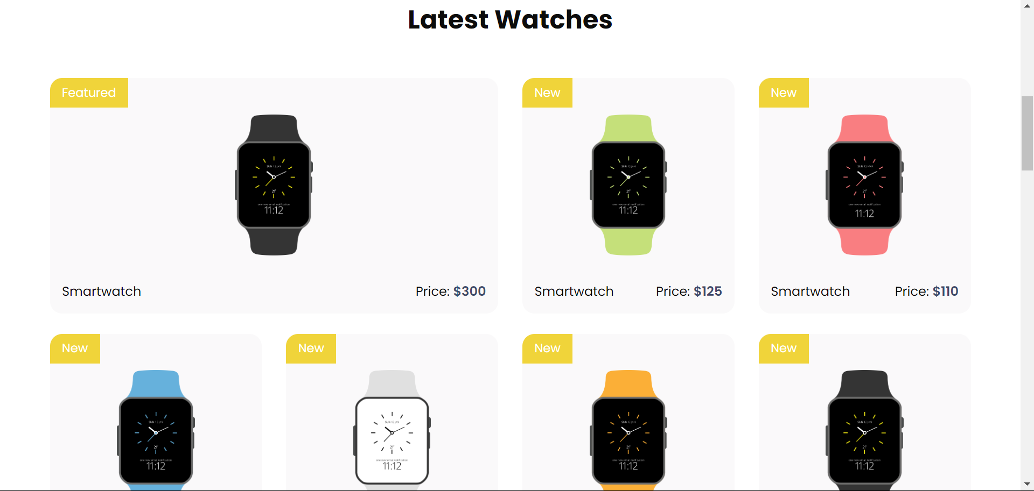
Objectives Continue.…
Quality
Targeted Audience
Goals
The website promises Quality over Quantity

Slide 28
Objectives Continue.…
Quality
Targeted Audience
Goals
The website promises Quality over Quantity

Slide 29
Objectives Continue.…
Ubiquitous
Blue is the color that is widely accepted by both men and women.
Hence, taking the monochromatic combination of Grayish-blue, Occur-yellow, and White.
This color combination gives the website a modern, polished appearance.
Targeted Audience
Goals
The website promises Quality over Quantity

Slide 30
Blue is the color that is widely accepted by both men and women.
Hence, taking the monochromatic combination of Grayish-blue, Occur-yellow, and White.
This color combination gives the website a modern, polished appearance.
Objectives Continue.…
Ubiquitous
Customer Empathy
All the factors previously discussed vitalize Empathy.
Customer Empathy is the most important element in customer retention.
Without customer empathy, the company will undoubtedly fail.
Targeted Audience
Goals
The website promises Quality over Quantity

Slide 31
Blue is the color that is widely accepted by both men and women.
Hence, taking the monochromatic combination of Grayish-blue, Occur-yellow, and White.
This color combination gives the website a modern, polished appearance.
Objectives Continue.…
Ubiquitous
Customer Empathy
In the event of any problems, customers must be aware of how to contact corporate management. All necessary contact information must be given.
Subscribing is another crucial element, for customers, that enables the user to get emails about new feeds. This enhances their desire to return to the website, which in turn boosts user retention.
Targeted Audience
Goals
The website promises Quality over Quantity

Slide 32
Blue is the color that is widely accepted by both men and women.
Hence, taking the monochromatic combination of Grayish-blue, Occur-yellow, and White.
This color combination gives the website a modern, polished appearance.
Objectives Continue.…
Ubiquitous
Customer Empathy
The user must get verification of their activities. This gives the user confidence, which makes him feel satisfied.
Targeted Audience
Goals
The website promises Quality over Quantity

Slide 33
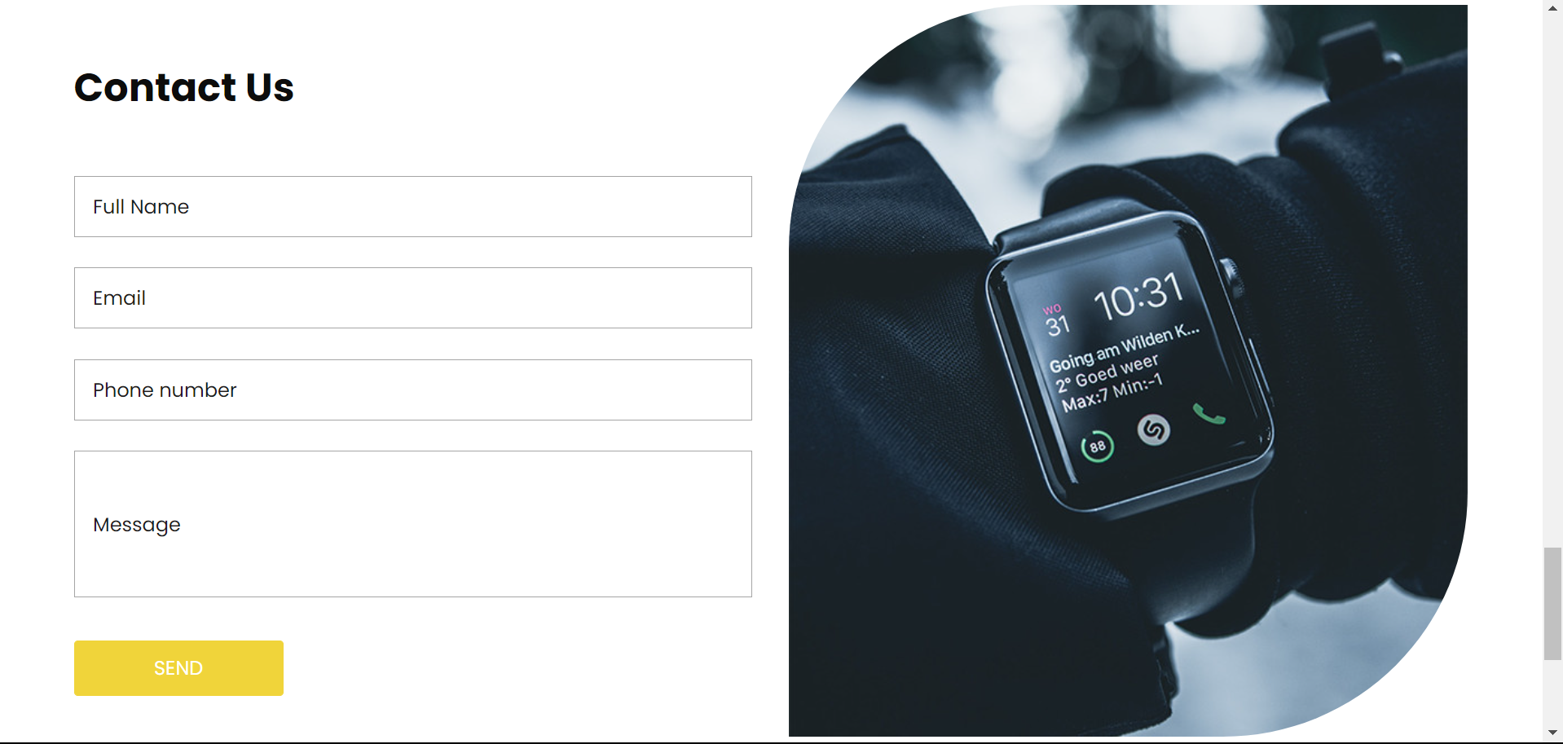
Objectives Continue.…
Ubiquitous
Customer Empathy
The user must get verification of their activities. This gives the user confidence, which makes him feel satisfied.
Targeted Audience
Goals
The website promises Quality over Quantity

Slide 34
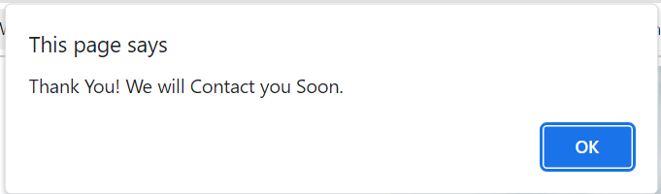


Objectives Continue.…
Ubiquitous
Customer Empathy
The user must get verification of their activities. This gives the user confidence, which makes him feel satisfied.
Targeted Audience
Goals
The website promises Quality over Quantity

Slide 35
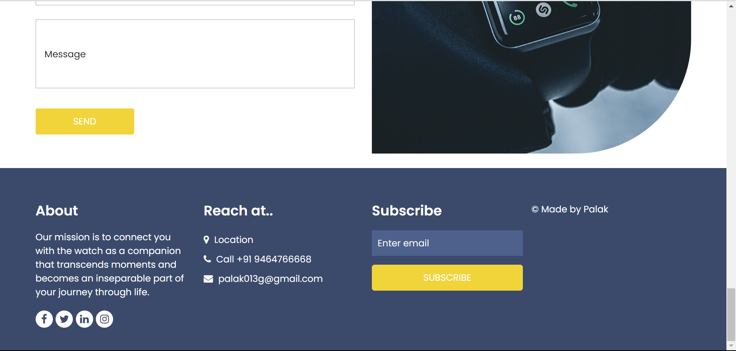
Objectives Continue.…
Ubiquitous
Customer Empathy
Targeted Audience
Goals
The website promises Quality over Quantity

Slide 36
Objectives Continue.…
Ubiquitous
Customer Empathy
Targeted Audience
Goals
The website promises Quality over Quantity

Slide 37
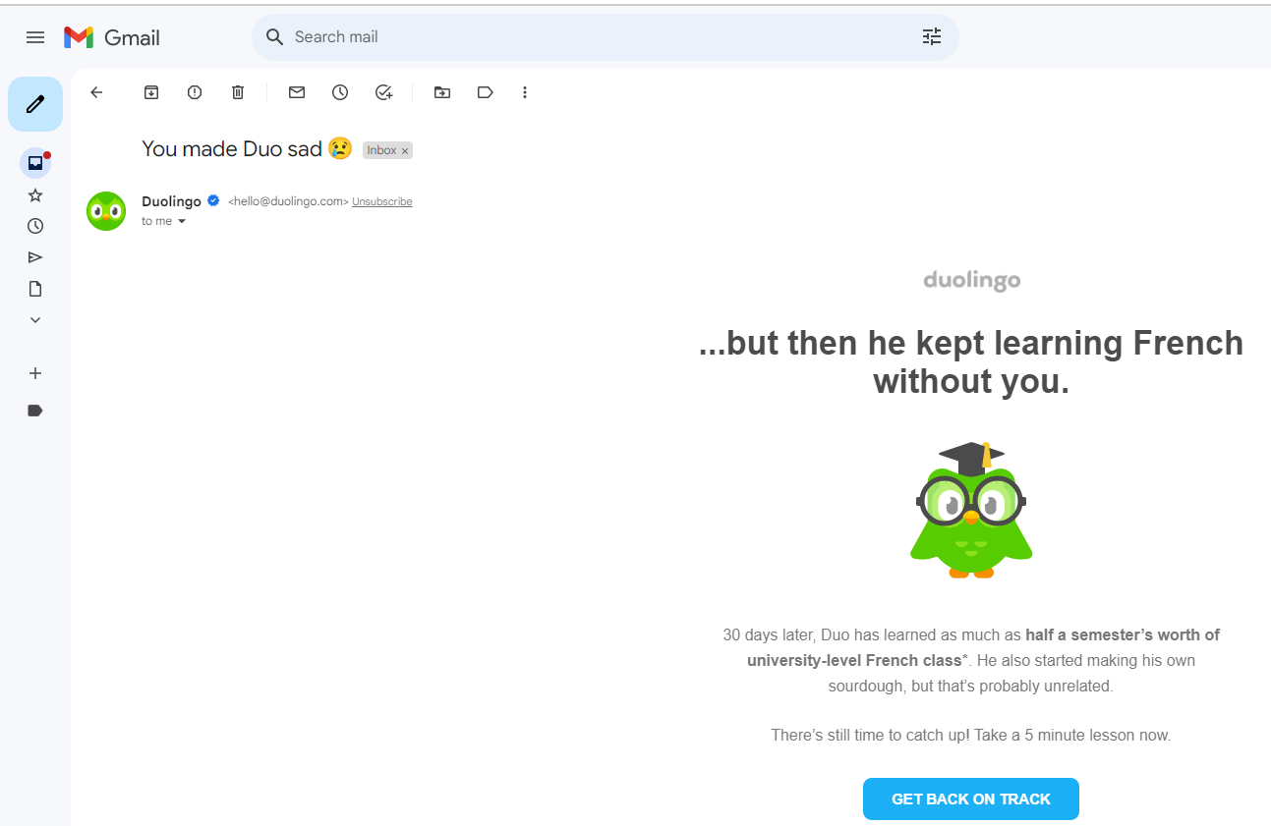
Objectives Continue.…
Ubiquitous
Customer Empathy
Targeted Audience
Goals
The website promises Quality over Quantity

Slide 38
Blue is the color that is widely accepted by both men and women.
Hence, taking the monochromatic combination of Grayish-blue, Occur-yellow, and White.
This color combination gives the website a modern, polished appearance.
Objectives Continue.…
Ubiquitous
Customer Empathy
The elements are the key to the customer Empathy.
Feasibility
01
02
User Engagement
Targeted Audience
Goals
Quality
04
03
Ubiquitous
The website promises Quality over Quantity

Slide 39
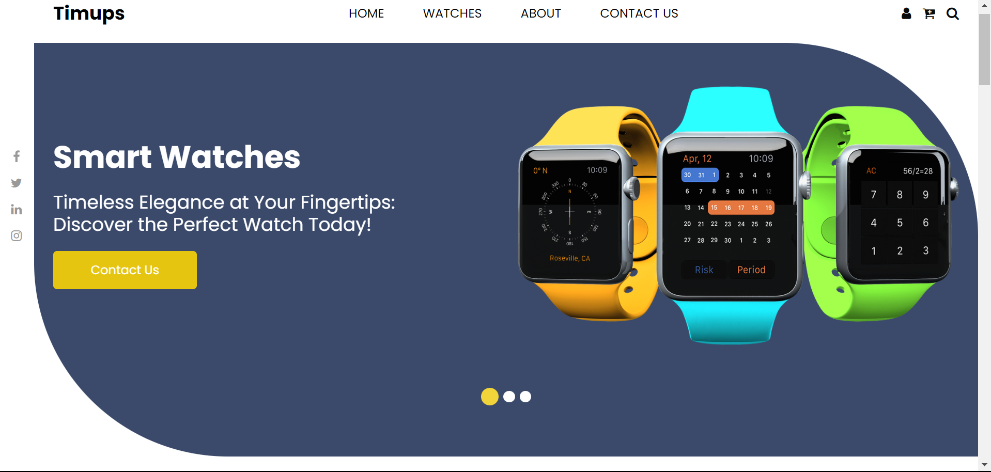
Blue is the color that is widely accepted by both men and women.
Hence, taking the monochromatic combination of Grayish-blue, Occur-yellow, and White.
This color combination gives the website a modern, polished appearance.
User Engagement
Objectives Continue.…
Ubiquitous
Quality
Feasible Maneuver
Ubiquitous
Targeted Audience
Goals
The website promises Quality over Quantity
01
02
Feasibility
04
03

Slide 40
Blue is the color that is widely accepted by both men and women.
Hence, taking the monochromatic combination of Grayish-blue, Occur-yellow, and White.
This color combination gives the website a modern, polished appearance.
User Engagement
Objectives Continue.…
Ubiquitous
Quality
Feasible Maneuver
Ubiquitous
Targeted Audience
Goals
The website promises Quality over Quantity
01
02
Feasibility
04
03

Slide 41
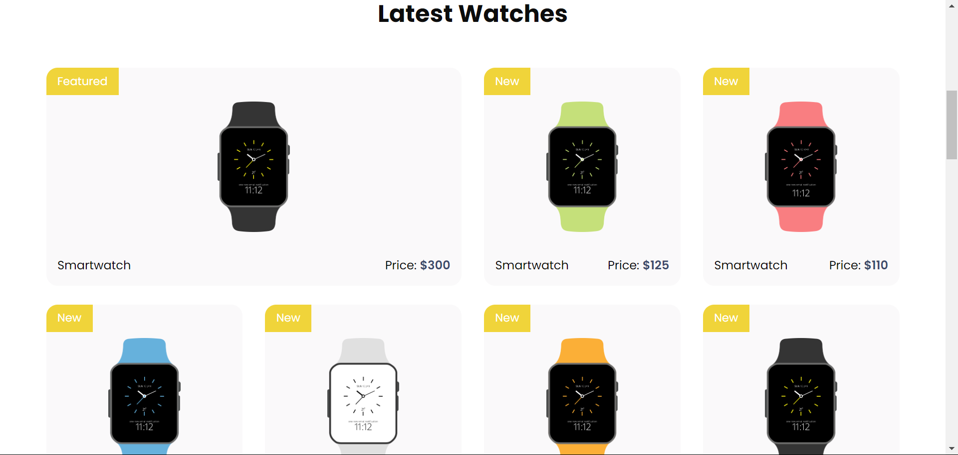
Blue is the color that is widely accepted by both men and women.
Hence, taking the monochromatic combination of Grayish-blue, Occur-yellow, and White.
This color combination gives the website a modern, polished appearance.
User Engagement
Objectives Continue.…
Ubiquitous
Quality
Feasible Maneuver
Ubiquitous
Targeted Audience
Goals
The website promises Quality over Quantity
01
02
Feasibility
04
03

Slide 42
Project Overview
Revolutionizing Wearables: Front-End Excellence for Smart Watches
Goals
Objectives
Targeted Audience
Millennials & Gen z

Slide 43
Targeted Audience
Age Range
Gender
Gen Z
Millennials
Males
Females
19-25
Age Group
27-40
Age Group
Others

Slide 44
Targeted Audience
Gen Z
Females
19-25
Age Group
Fine and sleek Design of the website
Color preferences
Gender
Age Range
Others
Gender
Females
Others
Millennials
Males
27-40
Age Group
Males

Slide 45
THANK YOU

